Slide 1
3413ICT Network Security
Trusted Computing, Security Management & Risk Assessment
Dr V. Muthukkumarasamy
B.Sc.Eng (Hons) (Peradeniya), PhD (Cantab), MIEE, MIEEE

Slide 2
Previous Lectures…
Have studied…
Introduced relational databases
Relational database elements
Inference
Statistical database security issues
Database encryption

Slide 3
Today’s Objectives
Trusted computing
Security issues in cloud computing
Understand the process involved in security management
Detail some alternative approaches to security risk assessment
Detail steps required in a formal IT security risk assessment
Characterize identified threats and consequences to determine risk
Detail risk treatment alternatives
Notes:
Now look at a simple form of encryption based on two concepts: the block cipher and the stream cipher.
Stream ciphers are based on a PRNG. The strength of the cipher depends on just how good the PRNG is. Good algorithms employ a lot of state and are highly secure. Stream ciphers must never re-use the same key and many mistakes occur because of this (Word/Excel encryption, WEP and so on).
With the block cipher method, the message is divided into blocks, i.e., 64 or 128 bit blocks, and then each block is transformed using the algorithm and key.

Slide 4
References
This lecture is based on
Computer Security Principles and Practice, (2nd Edition), W. Stallings & L. Brown,
Chapter 14
Other materials:
ISO/IEC standards
Research articles, including
S. Evans & J. Wallner, “Risk-based security engineering through the eyes of the adversary,” Workshop on Information Assurance and Security, West point, NY, 2005

Slide 5

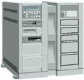
A Network Model
Users
Client Browser
Client Browser
Client Browser
Database Cluster(s)
DB2
databases
SQL
Server
Database
Cluster
Servers
Oracle
databases
Other
databases
Database
Connectivity
Web Server
Application Server

Slide 6
Security Threats
Users
Client Browser
Client Browser
Client Browser
Database Cluster(s)
DB2
databases
SQL
Server
Database
Cluster
Servers
Oracle
databases
Other
databases
Database
Connectivity
Web Server
Application Server

Slide 7
Important Topics of the Course
Authentication
Wireless security
Access control
Users
Client Browser
Client Browser
Client Browser
Database Cluster(s)
Advanced crypto
Security protocols
SSH, etc
DB2
databases
SQL
Server
Database
Cluster
Servers
Oracle
databases
Other
databases
Database
Connectivity
Database security
Access control
Web Server
Application Server
Anomaly detection
Security management
and risk assessment

Slide 8
Table 13.1 Terminology Related to Trust
Notes:
The models described in the preceding two sections are all aimed at enhancing
the trust that users and administrators have in the security of a computer
system. The concept of trust in the context of computer security goes back to
the early 1970s, spurred on by the U.S. Department of Defense initiative and
funding in this area. Early efforts were aimed to developing security models
and then designing and implementing hardware/software platforms to achieve
trust. Because of cost and performance issues, trusted systems did not gain a
serious foothold in the commercial market. More recently, the interest in trust
has reemerged, with the work on trusted computer platforms, a topic we explore
in Section 13.5 . In this section, we examine some basic concepts and implications
of trusted systems.
Some useful terminology related to trusted systems is listed in Table 13.1 .

Slide 9
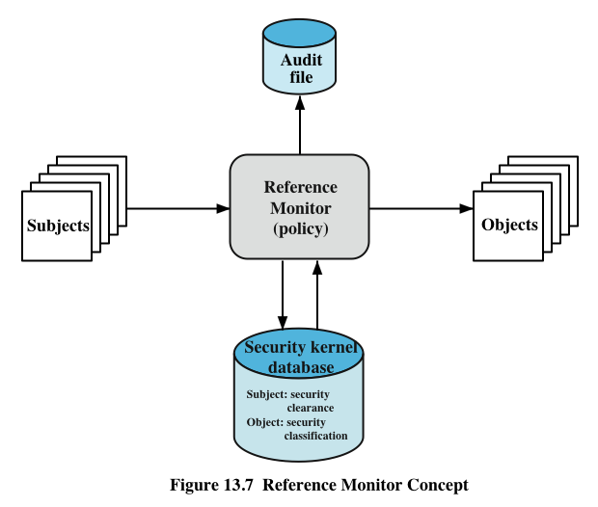
Reference Monitors
Notes:
Initial work on trusted computers and trusted operating systems was based on
the reference monitor concept, depicted in Figure 13.7 . The reference monitor is
a controlling element in the hardware and operating system of a computer that
regulates the access of subjects to objects on the basis of security parameters of
the subject and object. The reference monitor has access to a file, known as the
security kernel database , that lists the access privileges (security clearance) of
each subject and the protection attributes (classification level) of each object. The
reference monitor enforces the security rules (no read up, no write down) and has
the following properties:
• Complete mediation: The security rules are enforced on every access, not just,
for example, when a file is opened.
• Isolation: The reference monitor and database are protected from unauthorized
modification.
• Verifiability: The reference monitor’s correctness must be provable. That
is, it must be possible to demonstrate mathematically that the reference
monitor enforces the security rules and provides complete mediation and
isolation.
These are stiff requirements. The requirement for complete mediation means
that every access to data within main memory and on disk and tape must be mediated.
Pure software implementations impose too high a performance penalty to be practical;
the solution must be at least partly in hardware. The requirement for isolation means
that it must not be possible for an attacker, no matter how clever, to change the logic
of the reference monitor or the contents of the security kernel database. Finally, the
requirement for mathematical proof is formidable for something as complex as a
general-purpose computer. A system that can provide such verification is referred to
as a trustworthy system .
A final element illustrated in Figure 13.7 is an audit file. Important security
events, such as detected security violations and authorized changes to the security
kernel database, are stored in the audit file.
In an effort to meet its own needs and as a service to the public, the U.S.
Department of Defense in 1981 established the Computer Security Center within
the National Security Agency (NSA) with the goal of encouraging the widespread
availability of trusted computer systems. This goal is realized through the center’s
Commercial Product Evaluation Program. In essence, the center attempts to
evaluate commercially available products as meeting the security requirements
just outlined. The center classifies evaluated products according to the range of
security features that they provide. These evaluations are needed for Department
of Defense procurements but are published and freely available. Hence, they
can serve as guidance to commercial customers for the purchase of commercially
available, off-the-shelf equipment.

Slide 10
Trusted Platform Module (TPM)
concept from Trusted Computing Group
hardware module at heart of hardware/software approach to trusted computing (TC)
uses a TPM chip
motherboard, smart card, processor
working with approved hardware/software
generating and using crypto keys
has three basic services:
authenticated boot
certification
encryption
Notes:
The trusted platform module (TPM) is a concept being standardized by an industry
consortium, the Trusted Computing Group. The TPM is a hardware module that
is at the heart of a hardware/software approach to trusted computing. Indeed, the
term trusted computing (TC) is now used in the industry to refer to this type of
hardware/software approach.
The TC approach employs a TPM chip in personal computer motherboard
or a smart card or integrated into the main processor, together with hardware and
software that in some sense has been approved or certified to work with the TPM.
We can briefly describe the TC approach as follows. The TPM generates keys that
it shares with vulnerable components that pass data around the system, such as
storage devices, memory components, and audio/visual hardware. The keys can be
used to encrypt the data that flow throughout the machine. The TPM also works
with TC-enabled software, including the OS and applications. The software can be
assured that the data it receives are trustworthy, and the system can be assured that
the software itself is trustworthy.
To achieve these features, TC provides three basic services: authenticated
boot, certification, and encryption.

Slide 11
Authenticated Boot Service
responsible for booting entire OS in stages and ensuring each is valid and approved for use
at each stage digital signature associated with code is verified
TPM keeps a tamper-evident log of the loading process
log records versions of all code running
can then expand trust boundary to include additional hardware and application and utility software
confirms component is on the approved list, is digitally signed, and that serial number hasn’t been revoked
result is a configuration that is well-defined with approved components
Notes:
The authenticated boot service is responsible for booting the entire operating
system in stages and assuring that each portion of the OS, as it is loaded, is a
version that is approved for use. Typically, an OS boot begins with a small piece
of code in the Boot ROM. This piece brings in more code from the Boot Block
on the hard drive and transfers execution to that code. This process continues
with more and larger blocks of the OS code being brought in until the entire OS
boot procedure is complete and the resident OS is booted. At each stage, the
TC hardware checks that valid software has been brought in. This may be done
by verifying a digital signature associated with the software. The TPM keeps a
tamper-evident log of the loading process, using a cryptographic hash function to
detect any tampering with the log.
When the process is completed, the tamper-resistant log contains a record that
establishes exactly which version of the OS and its various modules are running. It
is now possible to expand the trust boundary to include additional hardware and
application and utility software. The TC-enabled system maintains an approved list
of hardware and software components. To configure a piece of hardware or load a
piece of software, the system checks whether the component is on the approved list,
whether it is digitally signed (where applicable), and that its serial number hasn’t
been revoked. The result is a configuration of hardware, system software, and
applications that is in a well-defined state with approved components.

Slide 12
Certification Service
once a configuration is achieved and logged the TPM can certify configuration to others
can produce a digital certificate
confidence that configuration is unaltered because:
TPM is considered trustworthy
only the TPM possesses this TPM’s private key
include challenge value in certificate to also ensure it is timely
provides a hierarchical certification approach
hardware/OS configuration
OS certifies application programs
user has confidence is application configuration
Notes:
Once a configuration is achieved and logged by the TPM, the TPM can certify the
configuration to other parties. The TPM can produce a digital certificate by signing
a formatted description of the configuration information using the TPM’s private
key. Thus, another user, either a local user or a remote system, can have confidence
that an unaltered configuration is in use because
1. The TPM is considered trustworthy. We do not need a further certification of
the TPM itself.
2. Only the TPM possesses this TPM’s private key. A recipient of the configuration
can use the TPM’s public key to verify the signature ( Figure 2.7b ).
To assure that the configuration is timely, a requester issues a “challenge” in
the form of a random number when requesting a signed certificate from the TPM.
The TPM signs a block of data consisting of the configuration information with
the random number appended to it. The requester therefore can verify that the
certificate is both valid and up to date.
The TC scheme provides for a hierarchical approach to certification. The
TPM certifies the hardware/OS configuration. Then the OS can certify the presence
and configuration of application programs. If a user trusts the TPM and trusts the
certified version of the OS, then the user can have confidence in the application’s
configuration.

Slide 13
Encryption Service
encrypts data so that it can only be decrypted by a machine with a certain configuration
TPM maintains a master secret key unique to machine
used to generate secret encryption key for every possible configuration of that machine
can extend scheme upward
provide encryption key to application so that decryption can only be done by desired version of application running on desired version of the desired OS
encrypted data can be stored locally or transmitted to a peer application on a remote machine
Notes:
The encryption service enables the encryption of data in such a way that the data
can be decrypted only by a certain machine and only if that machine is in a certain
configuration. There are several aspects of this service.
First, the TPM maintains a master secret key unique to this machine. From
this key, the TPM generates a secret encryption key for every possible configuration
of that machine. If data are encrypted while the machine is in one configuration, the
data can only be decrypted using that same configuration. If a different configuration
is created on the machine, the new configuration will not be able to decrypt the
data encrypted by a different configuration.
This scheme can be extended upward, as is done with certification. Thus, it is
possible to provide an encryption key to an application so that the application can
encrypt data, and decryption can only be done by the desired version of the desired
application running on the desired version of the desired OS. These encrypted data
can be stored locally, only retrievable by the application that stored them, or transmitted
to a peer application on a remote machine. The peer application would have
to be in the identical configuration to decrypt the data.
The encryption of a file proceeds in an analogous matter. In this latter case,
a process requests a symmetric key to encrypt the file. The TPM then provides an
encrypted version of the key to be stored with the file.

Slide 14
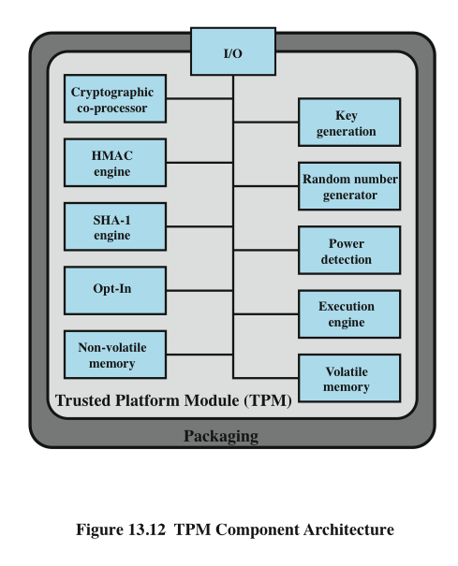
TPM Functions
Notes:
Figure 13.12 , based on the most recent TPM specification, is a block diagram of the
functional components of the TPM. These are as follows:
• I/O: All commands enter and exit through the I/O component, which provides
communication with the other TPM components.
• Cryptographic co-processor: Includes a processor that is specialized for
encryption and related processing. The specific cryptographic algorithms
implemented by this component include RSA encryption/decryption,
RSA-based digital signatures, and symmetric encryption.
• Key generation: Creates RSA public/private key pairs and symmetric keys.
• HMAC engine: This algorithm is used in various authentication protocols.
• Random number generator (RNG): This component produces random numbers
used in a variety of cryptographic algorithms, including key generation, random
values in digital signatures, and nonces. A nonce is a random number used once,
as in a challenge protocol. The RNG uses a hardware source of randomness
(manufacturer specific) and does not rely on a software algorithm that produces
pseudo random numbers.
SHA-1 engine: This component implements the SHA algorithm, which is used
in digital signatures and the HMAC algorithm.
• Power detection: Manages the TPM power states in conjunction with the
platform power states.
• Opt-in: Provides secure mechanisms to allow the TPM to be enabled or
disabled at the customer/user’s discretion.
• Execution engine: Runs program code to execute the TPM commands
received from the I/O port.
• Nonvolatile memory: Used to store persistent identity and state parameters
for this TPM.
• Volatile memory: Temporary storage for execution functions, plus storage
of volatile parameters, such as current TPM state, cryptographic keys, and
session information.

Slide 15

Security Assurance
“…degree of confidence that the security controls operate correctly and protect the system as intended. Assurance is not, however, an absolute guarantee that the measures work as intended.”
Notes:
The NIST Computer Security Handbook [NIST95] characterizes assurance in the
following way: “Security assurance is the degree of confidence one has that the
security controls operate correctly and protect the system as intended. Assurance
is not, however, an absolute guarantee that the measures work as intended.” As
with any other aspect of computer security, resources devoted to assurance must be
subjected to some sort of cost-benefit analysis to determine what amount of effort is
reasonable for the level of assurance desired.

Slide 16
Assurance and Evaluation
target audiences:
assurance
deals with security features of IT products
applies to:
requirements
security policy
product design
product implementation
system operation
consumers
select security features and functions
determine the required levels of security assurance
developers
respond to security requirements
interpret statements of assurance requirements
determine assurance approaches and level of effort
evaluators
use the assurance requirements as criteria when evaluating security features and controls
may be in the same organization as consumers or a third-party evaluation team
Notes:
The design of assurance measures depends in part on the target audience
for these measures. That is, in developing a degree of confidence in security
measures, we need to specify what individuals or groups possess that degree of
confidence. The CC document on assurance [CCPS09c] lists the following target
audiences:
• Consumers: Select security features and functions for a system and determine
the required levels of security assurance.
• Developers: Respond to actual or perceived consumer security requirements;
interpret statements of assurance requirements; and determine assurance
approaches and level of effort.
Evaluators: Use the assurance requirements as a mandatory statement of
evaluation criteria when evaluating security features and controls.
Evaluators may be in the same organization as consumers or a third-party
evaluation team.
Assurance deals with security features of IT products, such as computers, database
management systems, operating systems, and complete systems. Assurance applies
to the following aspects of a system:
• Requirements: This category refers to the security requirements for a product
• Security policy: Based on the requirements, a security policy can be defined
• Product design: Based on requirements and security policy
• Product implementation: Based on design
• System operation: Includes ordinary use plus maintenance
In each area, various approaches can be taken to provide assurance. [CCPS09c]
lists the following possible approaches:
• Analysis and checking of process(es) and procedure(s)
• Checking that process(es) and procedure(s) are being applied
• Analysis of the correspondence between TOE design representations
• Analysis of the TOE design representation against the requirements
• Verification of proofs
• Analysis of guidance documents
• Analysis of functional tests developed and the results provided
• Independent functional testing
• Analysis for vulnerabilities (including flaw hypothesis)
• Penetration testing

Slide 17

Cloud Computing
NIST definition of cloud computing:
A model for enabling ubiquitous, convenient, on-demand network access to a shared pool of configurable computing resources (e.g., networks, servers, storage, applications, and services) that can be rapidly provisioned and released with minimal management effort or service
provider interaction.
Notes:
There is an increasingly prominent trend in many organizations to move a
substantial portion or even all information technology (IT) operations to an
Internet-connected infrastructure known as enterprise cloud computing. The use
of cloud computing raises a number of security issues, particularly in the area of
database security.
NIST defines cloud computing as follows [MELL11]:
A model for enabling ubiquitous, convenient, on-demand
network access to a shared pool of configurable computing resources (e.g.,
networks, servers, storage, applications, and services) that can be rapidly
provisioned and released with minimal management effort or service provider
interaction. This cloud model promotes availability and is composed of five
essential characteristics, three service models, and four deployment models.

Slide 18
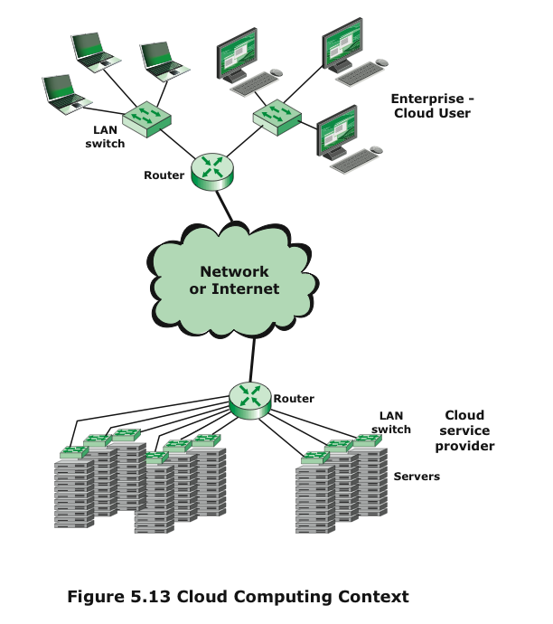
Cloud Computing Context
Notes:
Figure 5.13 illustrates the typical cloud service context. An enterprise maintains
workstations within an enterprise LAN or set of LANs, which are connected by
a router through a network or the Internet to the cloud service provider. The cloud
service provider maintains a massive collection of servers, which it manages with a
variety of network management, redundancy, and security tools. In the figure, the cloud
infrastructure is shown as a collection of blade servers, which is a common architecture.

Slide 19
Top 8 Cloud Computing Companies
19
Notes:
19
通过Force.com云服务免费建立你的网站
译言 于 2009-6-15,22:09 评论 (1)
今天Salesforce.com已经通过Force.com把企业云计算服务提升到了一个新高度。
该网站允许任何用户通过salesforce提供的云服务构架搭建一个全功能网站。也就是说，用户通过Force.com就可以搭建一个综合网站，自己只需通过HTML, JavaScript, Flex 和CSS设计用户界面。
同样的云服务，崭新的方法 Force.com是一个领先的平台， 开发者可以在上面开发应用产品。以前网页只是该公司的补充内容。但毫无疑问，后台服务可以为网站建设提供强大支持。 从今年二月份起，Force.com网站一直处在开发者预览阶段，为Salesforce.com的一些大客户网站提供了支持，其中包括 红十字会, Crocs, Dell, FICO, Juniper网络公司, NJ TRANSIT, Seagate, 和星巴克。用户只需自己开发前端，该网站使用了非常简单的Visualforce界面。 Salesforce.com把自己的新服务看成Java和.NET的备选方案。对于那些最想减少软件和硬件支出的人来说这是个好消息。 Salesforce.com和Nucleus Research进行的一项独立评估认为在Force.com上开发网站比传统方法更加快捷，让用户把精力放在用户体验和内容上。
一个可定制网站，100个用户，永远100%免费
为了鼓励新用户，Force.com允许任何人创建一个有100个用户的网站，永久免费，但很多用户已经超过了这个限制。但这种免费增值商业模式（freemium）可以让那些小公司也可以使用Force.com的服务。

Slide 20
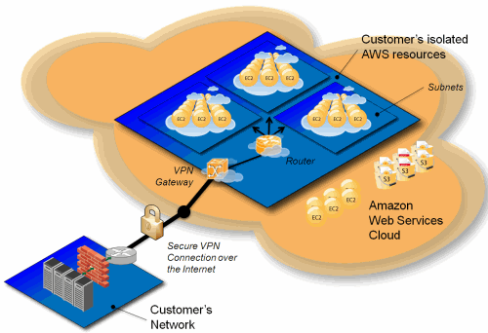
Amazon Virtual Private Cloud VPC (http://aws.amazon.com/vpc/ )
Notes:
通过Force.com云服务免费建立你的网站
译言 于 2009-6-15,22:09 评论 (1)
今天Salesforce.com已经通过Force.com把企业云计算服务提升到了一个新高度。
该网站允许任何用户通过salesforce提供的云服务构架搭建一个全功能网站。也就是说，用户通过Force.com就可以搭建一个综合网站，自己只需通过HTML, JavaScript, Flex 和CSS设计用户界面。
同样的云服务，崭新的方法 Force.com是一个领先的平台， 开发者可以在上面开发应用产品。以前网页只是该公司的补充内容。但毫无疑问，后台服务可以为网站建设提供强大支持。 从今年二月份起，Force.com网站一直处在开发者预览阶段，为Salesforce.com的一些大客户网站提供了支持，其中包括 红十字会, Crocs, Dell, FICO, Juniper网络公司, NJ TRANSIT, Seagate, 和星巴克。用户只需自己开发前端，该网站使用了非常简单的Visualforce界面。 Salesforce.com把自己的新服务看成Java和.NET的备选方案。对于那些最想减少软件和硬件支出的人来说这是个好消息。 Salesforce.com和Nucleus Research进行的一项独立评估认为在Force.com上开发网站比传统方法更加快捷，让用户把精力放在用户体验和内容上。
一个可定制网站，100个用户，永远100%免费
为了鼓励新用户，Force.com允许任何人创建一个有100个用户的网站，永久免费，但很多用户已经超过了这个限制。但这种免费增值商业模式（freemium）可以让那些小公司也可以使用Force.com的服务。

Slide 21
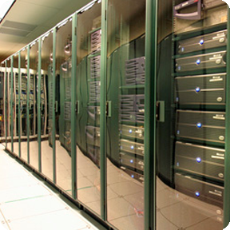
Cloud Computing – Service Provider Priorities
Effectively meet the advertised services, while optimizing cloud resource utilization
Offer tenants capabilities for self-service
Ensure confidentiality, integrity, and availability, as well as security assurance in a multi-tenant environment

Slide 22

Security Concerns
“Cloud Computing is a security nightmare and it can't be handled in traditional ways.”
—John Chambers
CISCO CEO
Security is one of the most difficult task to implement in cloud computing
Attacks with catastrophic effects only needs one security flaw
http://www.exforsys.com/tutorials/cloud-computing/cloud-computing-security.html

Slide 23

Security in Cloud Computing
In addition to traditional confidentiality, integrity, availability, and privacy issues, cloud users can suffer from additional security issues
The cloud acts as a big black box, nothing inside the cloud is visible to the clients
Clients have no idea or control over what happens inside a cloud
Even if the cloud provider is honest, it can have malicious system admins who can tamper with the VMs and violate confidentiality and integrity

Slide 24
Security Management Overview
Three fundamental questions:
What assets need to be protected ?
How are those assets threatened ?
What can be done to counter those threats ?
To ensure that critical assets are sufficiently protected in a cost-effective manner
Security risk assessment is needed for each asset that requires protection
To gain the information necessary to decide what management, operational, and technical controls are needed to reduce the risks
Notes:
Now look at a simple form of encryption based on two concepts: the block cipher and the stream cipher.
Stream ciphers are based on a PRNG. The strength of the cipher depends on just how good the PRNG is. Good algorithms employ a lot of state and are highly secure. Stream ciphers must never re-use the same key and many mistakes occur because of this (Word/Excel encryption, WEP and so on).
With the block cipher method, the message is divided into blocks, i.e., 64 or 128 bit blocks, and then each block is transformed using the algorithm and key.

Slide 25
Standards for Security Management
The ISO/IEC 27000 series standards, were published jointly by the International Organization for Standardization (ISO) and the International Electrotechnical Commission (IEC)
The series provides best practice recommendations, on security management, within the context of an overall information security management system (ISMS)
Given the dynamic nature of information security, a "plan-do-check-act" approach is recommended
At present, 11 standards in the series are published, while several more are still under development
Notes:
Now look at a simple form of encryption based on two concepts: the block cipher and the stream cipher.
Stream ciphers are based on a PRNG. The strength of the cipher depends on just how good the PRNG is. Good algorithms employ a lot of state and are highly secure. Stream ciphers must never re-use the same key and many mistakes occur because of this (Word/Excel encryption, WEP and so on).
With the block cipher method, the message is divided into blocks, i.e., 64 or 128 bit blocks, and then each block is transformed using the algorithm and key.

Slide 26
ISO/IEC 27000 Standards
Notes:
The discipline of IT security management has evolved considerably over the last few
decades. This has occurred in response to the rapid growth of, and dependence on, networked
computer systems and the associated rise in risks to these systems. In the last
decade a number of national and international standards have been published. These
represent a consensus on the best practice in the field. The International Standards
Organization (ISO) has revised and consolidated a number of these standards into the
ISO 27000 series. Table 14.1 details a number of recently adopted standards within
this family. In the United States, NIST has also produced a number of relevant standards,
including [NIST02] and [NIST09]. With the growth of concerns about corporate
governance following events such as the Enron collapse and repeated incidences
of the loss of personal information by government organizations, auditors for such
organizations increasingly require adherence to formal standards such as these.

Slide 27
IT Security Management Functions
IT security management functions include:
Determining organizational security objectives, strategies & policies
Determining organizational security requirements
Identifying and analyzing security threats to IT assets
Identifying and analyzing risks
Specifying appropriate safeguards
Monitoring the implementation and operation of safeguards
Developing and implement a security awareness program
Detecting and reacting to incidents
Notes:
[ISO13335] provides a conceptual framework for managing security. It defines
IT security management as follows:
IT SECURITY MANAGEMENT: A process used to achieve and maintain appropriate
levels of confidentiality, integrity, availability, accountability, authenticity, and reliability.
IT security management functions include:
• determining organizational IT security objectives, strategies, and policies
• determining organizational IT security requirements
• identifying and analyzing security threats to IT assets within the organization
• identifying and analyzing risks
• specifying appropriate safeguards
• monitoring the implementation and operation of safeguards that are necessary in
order to cost effectively protect the information and services within the organization
• developing and implementing a security awareness program
• detecting and reacting to incidents

Slide 28
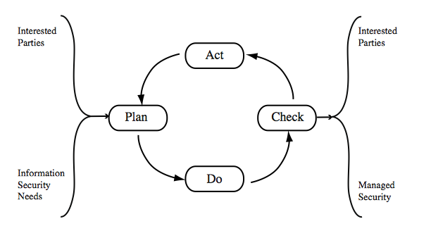
Plan - Do - Check - Act
Notes:
The iterative nature of this process is a key focus of [ISO27001], and is
specifically applied to the security risk management process in [ISO27005]. This
standard details a model process for managing information security that comprises
the following steps:
Plan establish security policy, objectives, processes and procedures;
perform risk assessment; develop risk treatment plan
with appropriate selection of controls or acceptance of risk.
Do implement the risk treatment plan.
Check monitor and maintain the risk treatment plan.
Act maintain and improve the information security risk management
process in response to incidents, review, or identified
changes.
This process is illustrated in Figure 14.2 (adapted from figure 1 in [ISO27001]),
which can be aligned with Figure 14.1 . The outcome of this process should be that
the security needs of the interested parties are managed appropriately.

Slide 29
Security Risk Assessment
It is a critical component of the management process
Ideally, every single organizational asset is examined
which is not feasible in practice
Approaches to identifying and mitigating risks to an organization’s IT infrastructure:
Baseline approach
Informal approach
Detailed risk analysis
Combined approach
Notes:
We now turn to the key risk management component of the IT security process.
This stage is critical, because without it there is a significant chance that resources
will not be deployed where most effective. The result will be that some risks are
not addressed, leaving the organization vulnerable, while other safeguards may be
deployed without sufficient justification, wasting time and money. Ideally every
single organizational asset is examined, and every conceivable risk to it is evaluated.
If a risk is judged to be too great, then appropriate remedial controls are deployed to
reduce the risk to an acceptable level. In practice this is clearly impossible. The time
and effort required, even for large, well-resourced organizations, is clearly neither
achievable nor cost effective. Even if possible, the rapid rate of change in both IT
technologies and the wider threat environment means that any such assessment
would be obsolete as soon as it is completed, if not earlier! Clearly some form of
compromise evaluation is needed.
Another issue is the decision as to what constitutes an appropriate level of
risk to accept. In an ideal world the goal would be to eliminate all risks completely.
Again, this is simply not possible. A more realistic alternative is to expend an amount
of resources in reducing risks proportional to the potential costs to the organization
should that risk occur. This process also must take into consideration the likelihood
of the risk’s occurrence. Specifying the acceptable level of risk is simply prudent
management and means that resources expended are reasonable in the context of
the organization’s available budget, time, and personnel resources. The aim of the
risk assessment process is to provide management with the information necessary for
them to make reasonable decisions on where available resources will be deployed.
Given the very wide range of organizations, from very small businesses to
global multinationals and national governments, there clearly needs to be a range of
alternatives available in performing this process. There are a range of formal standards
that detail suitable IT security risk assessment processes, including [ISO13335],
[ISO27005], and [NIST02]. In particular, [ISO13335] recognizes four approaches to
identifying and mitigating risks to an organization’s IT infrastructure:
• Baseline approach
• Informal approach
• Detailed risk analysis
• Combined approach
The choice among these will be determined by the resources available to the organization
and from an initial high-level risk analysis that considers how valuable the IT systems
are and how critical to the organization’s business objectives. Legal and regulatory
constraints may also require specific approaches. This information should be determined
when developing the organization’s IT security objectives, strategies, and policies.

Slide 30
Baseline Approach
The goal is to implement agreed controls to provide protection against the most common threats
It forms a good base for further security measures
Uses “industry best practice” – easy, cheap, can be replicated
But, it may give too much or too little security
It is generally recommended for small organizations without the resources to implement more structured approaches
Notes:
The baseline approach to risk assessment aims to implement a basic general level
of security controls on systems using baseline documents, codes of practice, and
industry best practice . The advantages of this approach are that it doesn’t require
the expenditure of additional resources in conducting a more formal risk assessment
and that the same measures can be replicated over a range of systems. The
major disadvantage is that no special consideration is given to variations in the organization’s
risk exposure based on who they are and how their systems are used.
Also, there is a chance that the baseline level may be set either too high, leading to
expensive or restrictive security measures that may not be warranted, or set too low,
resulting in insufficient security and leaving the organization vulnerable.
The goal of the baseline approach is to implement generally agreed controls to
provide protection against the most common threats. These would include implementing
industry best practice in configuring and deploying systems, like those we discuss in
Chapter 12 on operating systems security. As such, the baseline approach forms a good
base from which further security measures can be determined. Suitable baseline recommendations
and checklists may be obtained from a range of organizations, including
• Various national and international standards organizations
• Security-related organizations such as the CERT, NSA, and so on
• Industry sector councils or peak groups
The use of the baseline approach alone would generally be recommended only for
small organizations without the resources to implement more structured approaches.
But it will at least ensure that a basic level of security is deployed, which is not
guaranteed by the default configurations of many systems.

Slide 31
Informal Approach
It conducts informal, pragmatic risk analysis on organization’s IT systems
It exploits knowledge and expertise of analyst
Fairly quick and cheap
Some risks may be incorrectly assessed
Results may be skewed by analysts views, or varies over time
Suitable for small to medium sized organizations
Notes:
The informal approach involves conducting some form of informal, pragmatic risk analysis for the organization’s IT systems. This analysis does not involve the use of a formal, structured process, but rather exploits the knowledge and expertise of the individuals performing this analysis. These may either be internal experts if available, or alternatively external consultants. A major advantage of this approach is that the individuals performing the analysis require no additional skills. Hence an informal risk assessment can be performed relatively quickly and cheaply. In addition, since the organization’s systems are being examined, judgments can be made about specific vulnerabilities and risks to systems for the organization that the baseline approach would not address. Thus more accurate and targeted controls may be used than would be the case with the baseline approach. There are a number of disadvantages. Since a formal process is not used, there is a chance that some risks may not be considered appropriately, potentially leaving the organization vulnerable. As well, because the approach is informal, the results may be skewed by the views and prejudices of the individuals performing the analysis. It may also result in insufficient justification for suggested controls, leading to questions over whether the proposed expenditure is really justified. Lastly there may be inconsistent results over time as a result of differing expertise in those conducting the analysis. The use of the informal approach would generally be recommended for small to medium sized organizations where the IT systems are not necessarily essential to meeting the organization’s business objectives, and where additional expenditure on risk analysis cannot be justified.

Slide 32

Detailed Risk Analysis
It is the most comprehensive approach
It uses formal structured process
consists of a number of stages
identifies threats and vulnerabilities to assets
identifies likelihood of risk occurring and consequences
It may have significant cost in time, resources, and expertise
It may be a legal requirement to use
Suitable for large organizations with IT systems critical to their business objectives
Notes:
The informal approach involves conducting some form of informal, pragmatic risk analysis for the organization’s IT systems. This analysis does not involve the use of a formal, structured process, but rather exploits the knowledge and expertise of the individuals performing this analysis. These may either be internal experts if available, or alternatively external consultants. A major advantage of this approach is that the individuals performing the analysis require no additional skills. Hence an informal risk assessment can be performed relatively quickly and cheaply. In addition, since the organization’s systems are being examined, judgments can be made about specific vulnerabilities and risks to systems for the organization that the baseline approach would not address. Thus more accurate and targeted controls may be used than would be the case with the baseline approach. There are a number of disadvantages. Since a formal process is not used, there is a chance that some risks may not be considered appropriately, potentially leaving the organization vulnerable. As well, because the approach is informal, the results may be skewed by the views and prejudices of the individuals performing the analysis. It may also result in insufficient justification for suggested controls, leading to questions over whether the proposed expenditure is really justified. Lastly there may be inconsistent results over time as a result of differing expertise in those conducting the analysis. The use of the informal approach would generally be recommended for small to medium sized organizations where the IT systems are not necessarily essential to meeting the organization’s business objectives, and where additional expenditure on risk analysis cannot be justified.

Slide 33
Combined Approach
It combines elements of other approaches
initial baseline on all systems
informal analysis to identify critical risks
formal assessment on these risks
Ensures that a basic level of security protection is implemented early
For most organizations this approach is the most cost effective
Highly recommended for use
Notes:
The last approach combines elements of the baseline, informal, and detailed risk
analysis approaches. The aim is to provide reasonable levels of protection as quickly
as possible, and then to examine and adjust the protection controls deployed on key
systems over time. The approach starts with the implementation of suitable baseline
security recommendations on all systems. Next, systems either exposed to high risk
levels or critical to the organization’s business objectives are identified in the high level
risk assessment. A decision can then be made to possibly conduct an immediate
informal risk assessment on key systems, with the aim of relatively quickly
tailoring controls to more accurately reflect their requirements. Lastly, an ordered
process of performing detailed risk analyses of these systems can be instituted. Over
time this can result in the most appropriate and cost-effective security controls being
selected and implemented on these systems. This approach has a significant number
of advantages. The use of the initial high-level analysis to determine where further
resources need to be expended, rather than facing a full detailed risk analysis of
all systems, may well be easier to sell to management. It also results in the development
of a strategic picture of the IT resources and where major risks are likely
to occur. This provides a key planning aid in the subsequent management of the
organization’s security. The use of the baseline and informal analyses ensures that a
basic level of security protection is implemented early. And it means that resources
are likely to be applied where most needed and that systems most at risk are likely
to be examined further reasonably early in the process. However, there are some
disadvantages. If the initial high-level analysis is inaccurate, then some systems for
which a detailed risk analysis should be performed may remain vulnerable for some
time. Nonetheless, the use of the baseline approach should ensure a basic minimum
security level on such systems. Further, if the results of the high-level analysis are
reviewed appropriately, the chance of lingering vulnerability is minimized.
[ISO13335] considers that for most organizations, in most circumstances, this
approach is the most cost effective. Consequently its use is highly recommended.

Slide 34
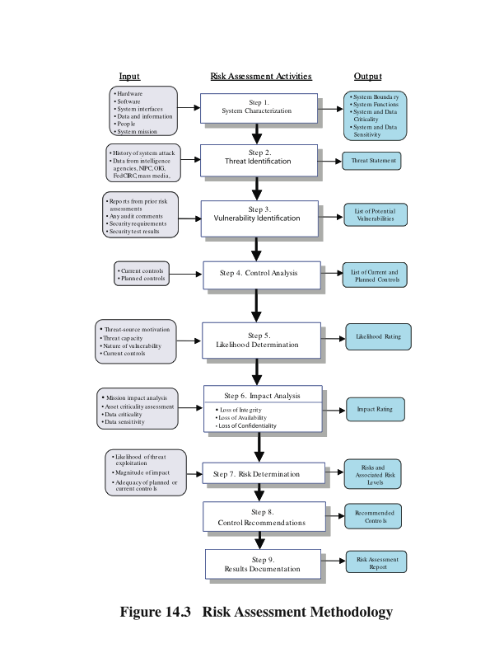
Risk
Assessment
Methodology
Notes:
A number of national and international standards document the expected formal
risk analysis approach. These include [ISO27005], [NIST02], [SASN04], [SASN06],
and [SA04]. This approach is often mandated by government organizations and associated
businesses. These standards all broadly agree on the process used. Figure 14.3
(reproduced from figure 3-1 in [NIST02]) illustrates a typical process used.

Slide 35
Establishing the Context
Establishing the context (system characterization) is the initial step of risk analysis
It determines the basic parameters of the risk assessment
identifies the assets to be examined
It also explores political and social environment in which the organization operates
legal and regulatory constraints
provide baseline for organization’s risk exposure
Risk appetite is defined by senior management
the level of risk the organization views as acceptable
Notes:
The initial step is known as establishing the context or system characterization . Its
purpose is to determine the basic parameters within which the risk assessment will
be conducted, and then to identify the assets to be examined.
The process starts with the organizational
security objectives and considers the broad risk exposure of the organization. This
recognizes that not all organizations are equally at risk, but that some, because of
their function, may be specifically targeted. It explores the relationship between
a specific organization and the wider political and social environment in which
it operates.
Industries such as agriculture and education are
considered to be at lesser risk compared to government or banking and finance. Note
that this classification predates September 11, and it is likely that there has been
change since it was developed. In particular it is likely that utilities, for example,
are probably at higher risk than the classification suggests. NIST has indicated that
the following industries are vulnerable to risks in Supervisory Control and Data
Acquisition (SCADA) and process control systems: electric, water and wastewater,
oil and natural gas, chemical, pharmaceutical, pulp and paper, food and beverage,
discrete manufacturing (automotive, aerospace, and durable goods), air and rail
transportation, and mining and metallurgy.
At this point in determining an organization’s broad risk exposure, any relevant
legal and regulatory constraints must also be identified. These features provide
a baseline for the organization’s risk exposure and an initial indication of the broad
scale of resources it needs to expend to manage this risk in order to successfully
conduct business.
Next, senior management must define the organization’s risk appetite , the
level of risk the organization views as acceptable. Again this will depend very much
on the type of organization, and its management’s attitude to how it conducts business.
For example, banking and finance organizations tend to be fairly conservative
and risk averse. This means they want a low residual risk and are willing to spend
the resources necessary to achieve this. In contrast, a leading-edge manufacturer
with a brand new product may have a much greater risk tolerance. The manufacturer
is willing to take a chance to obtain a competitive advantage, and with limited
resources wishes to expend less on risk controls. This decision is not just IT specific.
Rather it reflects the organization’s broader management approach to how it conducts
business.

Slide 36

Asset Identification
It is an important component of the first step
Assets:
“anything that needs to be protected”
has value to organization to meet its objectives
tangible or intangible
whose compromise or loss would seriously impact the operation of the organization
It needs to draw on expertise of people in relevant areas of organization to identify key assets
Notes:
The last component of this first step in the risk
assessment is to identify the assets to examine. This directly addresses the first of
the three fundamental questions we opened this chapter with: “What assets do
we need to protect?” An asset is “anything that needs to be protected” because
it has value to the organization and contributes to the successful attainment of
the organization’s objectives. As we discuss in Chapter 1 , an asset may be either
tangible or intangible. It includes computer and communications hardware
infrastructure, software (including applications and information/data held on these
systems), the documentation on these systems, and the people who manage and
maintain these systems. Within the boundaries identified for the risk assessment,
these assets need to be identified and their value to the organization assessed. It is
important to emphasize again that while the ideal is to consider every conceivable
asset, in practice this is not possible. Rather the goal here is to identify all assets
that contribute significantly to attaining the organization’s objectives and whose
compromise or loss would seriously impact on the organization’s operation.
[SASN06] describes this process as a criticality assessment that aims to identify
those assets that are most important to the organization.
While the risk assessment process is most likely being managed by security
experts, they will not necessarily have a high degree of familiarity with the
organization’s operation and structures. Thus they need to draw on the expertise
of the people in the relevant areas of the organization to identify key assets and
their value to the organization. A key element of this process step is identifying
and interviewing such personnel. Many of the standards listed previously include
checklists of types of assets and suggestions for mechanisms for gathering the
necessary information. These should be consulted and used. The outcome of this
step should be a list of assets, with brief descriptions of their use by, and value to,
the organization.

Slide 37

Threat Identification
Threat: Anything that might hinder or prevent an asset from providing appropriate levels of the key security services
Confidentiality
Integrity
Availability
Reliability
Authenticity
Accountability
Notes:
The last component of this first step in the risk
assessment is to identify the assets to examine. This directly addresses the first of
the three fundamental questions we opened this chapter with: “What assets do
we need to protect?” An asset is “anything that needs to be protected” because
it has value to the organization and contributes to the successful attainment of
the organization’s objectives. As we discuss in Chapter 1 , an asset may be either
tangible or intangible. It includes computer and communications hardware
infrastructure, software (including applications and information/data held on these
systems), the documentation on these systems, and the people who manage and
maintain these systems. Within the boundaries identified for the risk assessment,
these assets need to be identified and their value to the organization assessed. It is
important to emphasize again that while the ideal is to consider every conceivable
asset, in practice this is not possible. Rather the goal here is to identify all assets
that contribute significantly to attaining the organization’s objectives and whose
compromise or loss would seriously impact on the organization’s operation.
[SASN06] describes this process as a criticality assessment that aims to identify
those assets that are most important to the organization.
While the risk assessment process is most likely being managed by security
experts, they will not necessarily have a high degree of familiarity with the
organization’s operation and structures. Thus they need to draw on the expertise
of the people in the relevant areas of the organization to identify key assets and
their value to the organization. A key element of this process step is identifying
and interviewing such personnel. Many of the standards listed previously include
checklists of types of assets and suggestions for mechanisms for gathering the
necessary information. These should be consulted and used. The outcome of this
step should be a list of assets, with brief descriptions of their use by, and value to,
the organization.

Slide 38
Threat Sources
A threat may be
natural “acts of god”, or
man-made and either accidental or deliberate
Should consider the reason and capabilities of attackers:
motivation
capability
resources
probability of attack
deterrence
Any previous history of attack on organization
Notes:
A threat may be either natural or human-made and may be accidental or deliberate.
This is known as the threat source . The classic natural threat sources are those often
referred to as acts of God, and include damage caused by fire, flood, storm, earthquake,
and other such natural events. It also includes environmental threats such as long term
loss of power or natural gas. Or it may be the result of chemical contamination
or leakage. Alternatively, a threat source may be a human agent acting either directly
or indirectly. Examples of the former include an insider retrieving and selling information
for personal gain or a hacker targeting the organization’s server over the Internet.
An example of the latter includes someone writing and releasing a network worm that
infects the organization’s systems. These examples all involved a deliberate exploit of a
threat. However, a threat may also be a result of an accident, such as an employee incorrectly
entering information on a system, which results in the system malfunctioning.
Identifying possible threats and threat sources requires the use of a variety of
sources, along with the experience of the risk assessor. The chance of natural threats
occurring in any particular area is usually well known from insurance statistics. Lists
of other potential threats may be found in the standards, in the results of IT security
surveys, and in information from government security agencies. The annual computer
crime reports, such as those by CSI/FBI and by Verizon in the United States,
and similar reports in other countries, provide useful general guidance on the broad
IT threat environment and the most common problem areas.
However, this general guidance needs to be tailored to the organization and
the risk environment it operates in. This involves consideration of vulnerabilities in
the organization’s IT systems, which may indicate that some risks are either more
or less likely than the general case. The possible motivation of deliberate attackers
in relation to the organization should be considered as potentially influencing this
variation. In addition, any previous experience of attacks seen by the organization
needs to be considered, as that is concrete evidence of risks that are known to occur.
When evaluating possible human threat sources, it is worth considering their reason
and capabilities for attacking this organization, including their
• Motivation: Why would they target this organization; how motivated are they?
• Capability: What is their level of skill in exploiting the threat?
Resources: How much time, money, and other resources could they deploy?
• Probability of attack: How likely and how often would your assets be targeted?
• Deterrence: What are the consequences to the attacker of being identified?

Slide 39
Analyze Risks
Includes specifying likelihood of occurrence of each identified threat to asset given existing controls, and
specifying the consequence should threat occur
Overall risk rating for each threat
Risk = (Probability threat occurs) × (Cost to organization)
There are different methods to determine these parameters
For example, a method by S. Evans & J. Wallner
─ “Risk-based security engineering through the eyes of the adversary,” Workshop on Infor. Assurance & Security, West point, NY, 2005
However, it may be a challenge to guarantee the accuracy
Notes:
Having identified key assets and the likely threats and vulnerabilities they are
exposed to, the next step is to determine the level of risk each of these poses to the
organization. The aim is to identify and categorize the risks to assets that threaten
the regular operations of the organization. Risk analysis also provides information
to management to help managers evaluate these risks and determine how best to
treat them. Risk analysis involves first specifying the likelihood of occurrence of
each identified threat to an asset, in the context of any existing controls. Next, the
consequence to the organization is determined, should that threat eventuate. Lastly,
this information is combined to derive an overall risk rating for each threat. The
ideal would be to specify the likelihood as a probability value and the consequence
as a monetary cost to the organization should it occur. The resulting risk is then
simply given as
Risk = (Probability that threat occurs) x (Cost to organization)
This can be directly equated to the value the threatened asset has for the organization,
and hence specify what level of expenditure is reasonable to reduce the
probability of its occurrence to an acceptable level. Unfortunately, it is often
extremely hard to determine accurate probabilities, realistic cost consequences,
or both. This is particularly true of intangible assets, such as the loss of confidentiality
of a trade secret. Hence, most risk analyses use qualitative, rather than
quantitative, ratings for both these items. The goal is then to order the resulting
risks to help determine which need to be most urgently treated, rather than to
give them an absolute value.

Slide 40
Analyze Existing Controls
Before specifying the likelihood of a threat, existing controls used to attempt to minimize threats need to be identified
Security controls include:
management
operational
technical processes and procedures
Use checklists of existing controls and interview key organizational staff to solicit information
Notes:
Before the likelihood of a threat can be specified,
any existing controls used by the organization to attempt to minimize threats need
to be identified. Security controls include management, operational, and technical
processes and procedures that act to reduce the exposure of the organization to
some risks by reducing the ability of a threat source to exploit some vulnerabilities.
These can be identified by using checklists of existing controls, and by interviewing
key organizational staff to solicit this information.

Slide 41
Risk Likelihood
Notes:
Having identified existing controls, the likelihood
that each identified threat could occur and cause harm to some asset needs to
be specified. The likelihood is typically described qualitatively, using values and
descriptions such as those shown in Table 14.2 . While the various risk assessment
standards all suggest tables similar to these, there is considerable variation in their
detail. The selection of the specific descriptions and tables used is determined at
the beginning of the risk assessment process, when the context is established.
There will very likely be some uncertainty and debate over exactly which rating
is most appropriate. This reflects the qualitative nature of the ratings, ambiguity
in their precise meaning, and uncertainty over precisely how likely it is that some
threat may eventuate. It is important to remember that the goal of this process is
to provide guidance to management as to which risks exist, and provide enough
information to help management decide how to most appropriately respond. Any
uncertainty in the selection of ratings should be noted in the discussion on their
selection, but ultimately management will make a business decision in response to
this information.
The risk analyst takes the descriptive asset and threat/vulnerability details
from the preceding steps in this process and, in light of the organization’s overall
risk environment and existing controls, decides the appropriate rating. This
estimation relates to the likelihood of the specified threat exploiting one or
more vulnerabilities to an asset or group of assets, which results in harm to the
organization. The specified likelihood needs to be realistic. In particular, a rating
of likely or higher suggests that this threat has occurred sometime previously. This
means past history provides supporting evidence for its specification. If this is
not the case, then specifying such a value would need to be justified on the basis
of a significantly changed threat environment, a change in the IT system that
has weakened its security, or some other rationale for the threat’s anticipated
likely occurrence. In contrast, the Unlikely and Rare ratings can be very hard to
quantify. They are an indication that the threat is of concern, but whether it could
occur is difficult to specify. Typically such threats would only be considered if the
consequences to the organization of their occurrence are so severe that they must
be considered, even if extremely improbable.

Slide 42
Risk Likelihood: An Example
It is based on the work by S. Evans and J. Waller and other researchers
It determined likelihood of an attack by the following formula:
R = (w_{cost} ×u_{cost}) + (w_{capab} ×u_{capab}) + (w_{det} ×u_{det})
where
w_{cost} / w_{capab} / w_{det} = weighting of cost / capability / detectability
u_{cost} / u_{capab} / u_{det} = the adversary’s utility of cost / capability /
detectability
Notes:
Before the likelihood of a threat can be specified,
any existing controls used by the organization to attempt to minimize threats need
to be identified. Security controls include management, operational, and technical
processes and procedures that act to reduce the exposure of the organization to
some risks by reducing the ability of a threat source to exploit some vulnerabilities.
These can be identified by using checklists of existing controls, and by interviewing
key organizational staff to solicit this information.

Slide 43
Risk Consequences
Notes:
The analyst must then
specify the consequence of a specific threat eventuating. Note this is distinct from,
and not related to, the likelihood of the threat occurring. Rather, consequence
specification indicates the impact on the organization should the particular threat
in question actually eventuate. Even if a threat is regarded as rare or unlikely, if
the organization would suffer severe consequence should it occur, then it clearly
poses a risk to the organization. Hence, appropriate responses must be considered.
A qualitative descriptive value, such as those shown in Table 14.3 , is typically used
to describe the consequence. As with the likelihood ratings, there is likely to be
some uncertainty as to the best rating to use.
This determination should be based upon the judgment of the asset’s owners,
and the organization’s management, rather than the opinion of the risk analyst. This
is in contrast with the likelihood determination. The specified consequence needs to
be realistic. It must relate to the impact on the organization as a whole should this
specific threat eventuate. It is not just the impact on the affected system. It is possible
that a particular system (a server in one location, for example) might be completely
destroyed in a fire. However, the impact on the organization could vary from it being
a minor inconvenience (the server was in a branch office, and all data were replicated
elsewhere) to a major disaster (the server had the sole copy of all customer
and financial records for a small business). As with the likelihood ratings, the consequence
ratings must be determined knowing the organization’s current practices and
arrangements. In particular, the organization’s existing backup, disaster recovery,
and contingency planning, or lack thereof, will influence the choice of rating.

Slide 44
Risk Level Determination and Meaning
Notes:
Once the likelihood and consequence
of each specific threat have been identified, a final level of risk can be assigned.
This is typically determined using a table that maps these values to a risk level,
such as those shown in Table 14.4 . This table details the risk level assigned to each
combination. Such a table provides the qualitative equivalent of performing the
ideal risk calculation using quantitative values. It also indicates the interpretation
of these assigned levels.

Slide 45
Risk Register
The results of the risk analysis process should be documented in a risk register
An example:
Notes:
Having identified existing controls, the likelihood
that each identified threat could occur and cause harm to some asset needs to
be specified. The likelihood is typically described qualitatively, using values and
descriptions such as those shown in Table 14.2 . While the various risk assessment
standards all suggest tables similar to these, there is considerable variation in their
detail. The selection of the specific descriptions and tables used is determined at
the beginning of the risk assessment process, when the context is established.
There will very likely be some uncertainty and debate over exactly which rating
is most appropriate. This reflects the qualitative nature of the ratings, ambiguity
in their precise meaning, and uncertainty over precisely how likely it is that some
threat may eventuate. It is important to remember that the goal of this process is
to provide guidance to management as to which risks exist, and provide enough
information to help management decide how to most appropriately respond. Any
uncertainty in the selection of ratings should be noted in the discussion on their
selection, but ultimately management will make a business decision in response to
this information.
The risk analyst takes the descriptive asset and threat/vulnerability details
from the preceding steps in this process and, in light of the organization’s overall
risk environment and existing controls, decides the appropriate rating. This
estimation relates to the likelihood of the specified threat exploiting one or
more vulnerabilities to an asset or group of assets, which results in harm to the
organization. The specified likelihood needs to be realistic. In particular, a rating
of likely or higher suggests that this threat has occurred sometime previously. This
means past history provides supporting evidence for its specification. If this is
not the case, then specifying such a value would need to be justified on the basis
of a significantly changed threat environment, a change in the IT system that
has weakened its security, or some other rationale for the threat’s anticipated
likely occurrence. In contrast, the Unlikely and Rare ratings can be very hard to
quantify. They are an indication that the threat is of concern, but whether it could
occur is difficult to specify. Typically such threats would only be considered if the
consequences to the organization of their occurrence are so severe that they must
be considered, even if extremely improbable.

Slide 46
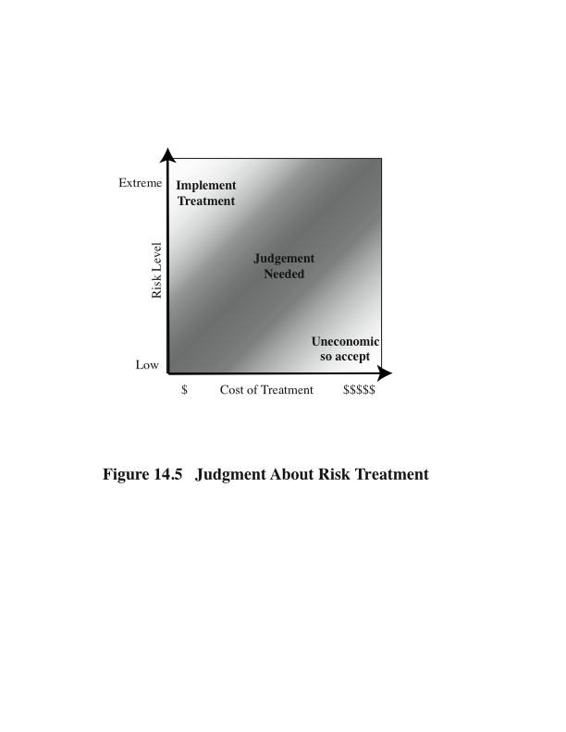
Risk Treatment
Some risks can be treated by a relatively simpler and cheaper action
Management can take the simple action first to improve the overall risk profile as soon as possible
Notes:
Typically the risks with the higher ratings are those that need action most urgently.
However, it is likely that some risks will be easier, faster, and cheaper to address
than others. In the example risk register shown in Table 14.5 , both risks were rated
High. Further investigation reveals that a relatively simple and cheap treatment
exists for the first risk by tightening the router configuration to further restrict possible
accesses. Treating the second risk requires developing a full disaster recovery
plan, a much slower and more costly process. Hence management would take the
simple action first to improve the organization’s overall risk profile as quickly as
possible. Management may even decide that for business reasons, given an overall
view of the organization, some risks with lower levels should be treated ahead of
other risks. This is a reflection of both limitations in the risk analysis process in the
range of ratings available and their interpretation, and of management’s perspective
of the organization as a whole.
Figure 14.5 indicates a range of possibilities for costs versus levels of risk.
If the cost of treatment is high, but the risk is low, then it is usually uneconomic
to proceed with such treatment. Alternatively, where the risk is high and the cost
comparatively low, treatment should occur. The most difficult area occurs between
these extremes. This is where management must make a business decision about the
most effective use of their available resources. This decision usually requires a more
detailed investigation of the treatment options.

Slide 47
Risk Treatment Alternatives
Risk acceptance
Risk avoidance
Risk transfer
Reduce consequence
Reduce likelihood
Notes:
A case study involving the operations of a fictional company Silver Star Mines illustrates
this risk assessment process. Silver Star Mines is the local operations of a large global
mining company. It has a large IT infrastructure used by numerous business areas.
Its network includes a variety of servers, executing a range of application software
typical of organizations of its size. It also uses applications that are far less common,
some of which directly relate to the health and safety of those working in the mine.
Many of these systems used to be isolated, with no network connections among them.
In recent years, they have been connected together and connected to the company’s
intranet to provide better management capabilities. However, this means they are
now potentially accessible from the Internet, which has greatly increased the risks to
these systems.
A security analyst was contracted to provide an initial review of the company’s
risk profile and to recommend further action for improvement. Following
initial discussion with company management, a decision was made to adopt a
combined approach to security management. This requires the adoption of suitable
baselines standards by the company’s IT support group for their systems.
Meanwhile, the analyst was asked to conduct a preliminary formal assessment of
the key IT systems to identify those most at risk, which management could then
consider for treatment.
The first step was to determine the context for the risk assessment. Being in
the mining industry sector places the company at the less risky end of the spectrum,
and consequently less likely to be specifically targeted. Silver Star Mines is part
of a large organization and hence is subject to legal requirements for occupational
health and safety and is answerable to its shareholders. Thus management decided
that it wished to accept only moderate or lower risks in general. The boundaries
for this risk assessment were specified to include only the systems under the direct
control of the Silver Star Mines operations. This excluded the wider company
intranet, its central servers, and its Internet gateway. This assessment is sponsored
by Silver Star’s IT and engineering managers, with results to be reported to the
company board. The assessment would use the process and ratings described in
this chapter.

Slide 48
Summary
We have studied:
Trusted computing
Security issues in cloud computing
Security management
Approaches to security risk assessment
Risk treatment alternatives

Slide 49
Next Week
Mini_Test 2
Lecture..

Slide 50

Questions?

